Slide 1
INFSCI 2500 Lecture 3 Analysis of Algorithms and Recursion

Slide 2
Today’s Goals
Review Homework 1
Understand Big-O notation
Conduct runtime analyses
Understand Recursion
Recognize where recursion is useful
Compare recursive and iterative solutions
Trace the execution of a recursive method
Assign Homework 2

Slide 3
Homework 1 Review

Slide 4
Effectiveness vs Efficiency
What is the method supposed to do?
How does the method do that?
How do we measure efficiency?
Time it?
Investigate directly?
Outside of a computing environment?

Slide 5
Running Time
Number of statements executed proportional to run time
Size of problem: n
worstTime(n)
Maximum number of statements executed
averageTime(n)
Average number of statements executed
bestTime(n)
Minimum number of statements executed

Slide 6
Worst Time Example
public static int aboveMeanCount(double[] a, double mean){
int count=0;
for(int i=0;i<a.length;i++){
if(a[i]>mean){
count++;
}
}
return count;
}
What is the problem size?
What is the worstTime(n)?

Slide 7
Worst Time Example
public static int aboveMeanCount(double[] a, //1,1 double mean){
int count=0; //1
for(int i=0;i<a.length;i++){ //1,n+1,n
if(a[i]>mean){ //n
count++; //n-1
}
}
return count; //1
}
worstTime(n)=5+(n+1)+n+n+(n-1)=4n+5

Slide 8
Average Time Example
public static int aboveMeanCount(double[] a, //1,1 double mean){
int count=0; //1
for(int i=0;i<a.length;i++){ //1,n+1,n
if(a[i]>mean){ //n
count++; //n/2
}
}
return count; //1
}
averageTime(n)=5+(n+1)+n/2+n+(n-1)=3.5n+5

Slide 9
Best Time Example
public static int aboveMeanCount(double[] a, //1,1 double mean){
int count=0; //1
for(int i=0;i<a.length;i++){ //1,n+1,n
if(a[i]>mean){ //n
count++; //1
}
}
return count; //1
}
bestTime(n)=6+(n+1)+n+(n-1)=3n+6

Slide 10
Big-O Notation
worstTime,averageTime are crude approximations
We are removed from a computing environment
We can use an approximate approximation
We only care about an upper bound!
“How bad can it get?”

Slide 11
Big-O Definition
Let g be a function that has nonnegative integer arguments and returns a nonnegative value for all arguments. A function f is said to be O(g) if for some pair of nonnegative constants C and K:
f(n)<=Cg(n) for all n>=K
Got it???

Slide 12
Big-O Simplified
We care about the “order” of the worstTime(n) value
worstTime(n) = 4n+5 = O(n)
“The method is big-oh of n”
“Time complexity of n”

Slide 13
Big-O Example
for(int i=0;i<n;i++){
for(int j=0;j<n;j++){
System.out.println(i+j);
}
}

Slide 14
Big-O Example
for(int i=0;i<n;i++){ //1,n+1,n
for(int j=0;j<n;j++){ //n(1,n+1,n)
System.out.println(i+j); n(n)
}
}
worstTime(n)=1+(n+1)+n+n(1+(n+1)+n)=
2n²+4n+2

Slide 15
Big-O Example
for(int i=0;i<n;i++){ //1,n+1,n
for(int j=0;j<n;j++){ //n(1,n+1,n)
System.out.println(i+j); n(n)
}
}
worstTime(n)=1+(n+1)+n+n(1+(n+1)+n)=
2n²+4n+2
=O(n²)

Slide 16
Common Big-O Values
O(1)
O(log n)
O(n)
O(n log n)
O(n²)
O(n³) & so on
O(2^{n})

Slide 17
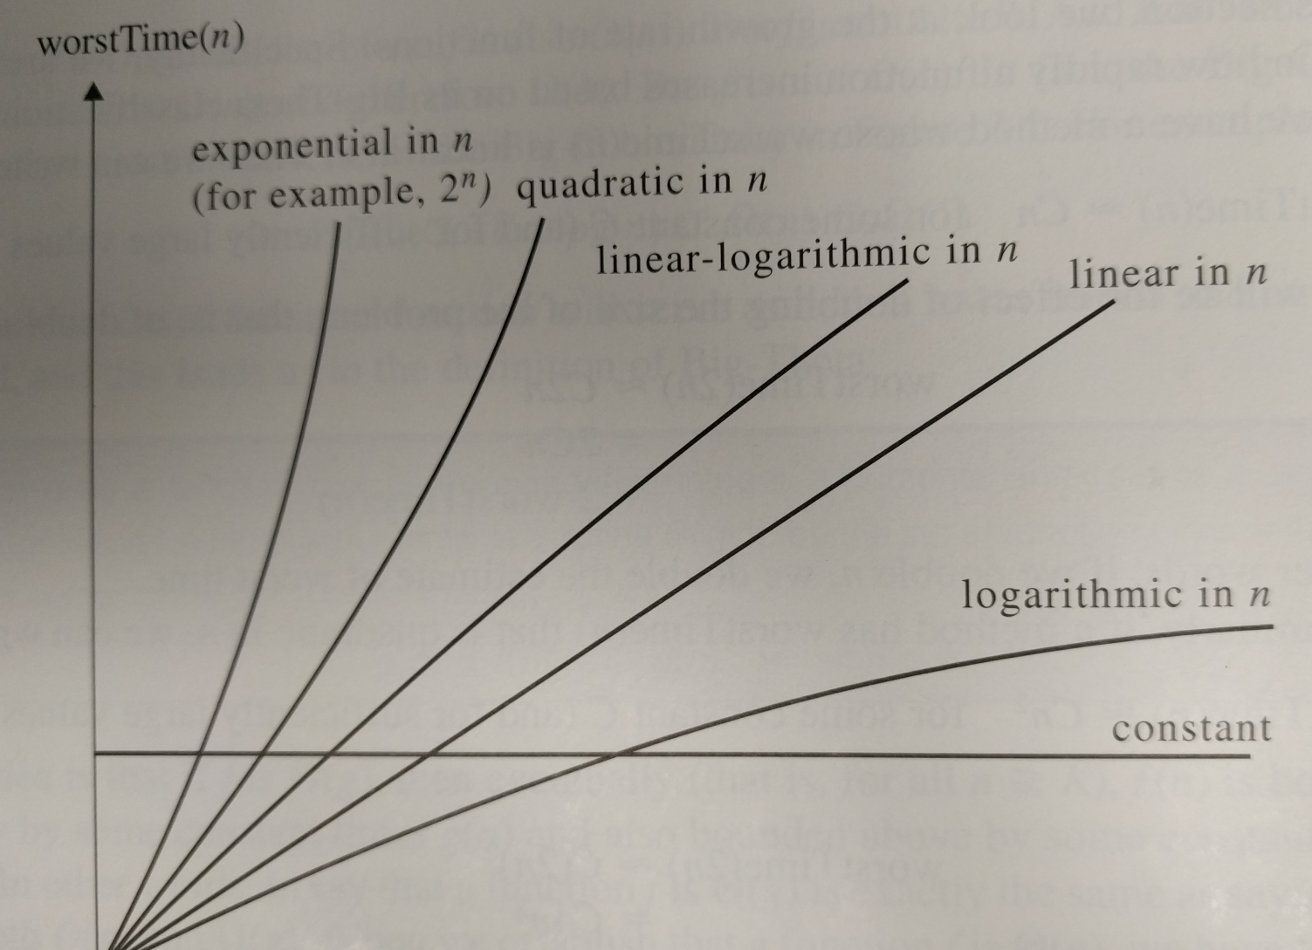
Growth Rate

Slide 18
Finding Big-O Quickly
Estimate the number of loop iterations
How it that related to n?

Slide 19
Big-O Example 1
double sum=0;
for(int i=0;i<100000000;i++){
sum+=Math.sqrt(i);
}

Slide 20
Big-O Example 1
double sum=0; //1
for(int i=0;i<1000000000;i++){ //1, 1 billion+1,
1billion
sum+=Math.sqrt(i); //1 billion
}
worstTime(n)=1+1+1+3 billion
Just a constant
=O(1) “constant time”

Slide 21
Big-O Example 2
while(n>1){
n/=2;
}

Slide 22
Big-O Example 2
while(n>1){
n/=2; //log n
}
O(log n) “logarithmic time”
Splitting rule:
In general, if n (the problem size) is split up in some way within a loop, it will be O(log n)

Slide 23
Big-O Example 3
for(int i=0;i<n;i++){
System.out.println(i);
}

Slide 24
Big-O Example 3
for(int i=0;i<n;i++){ //1,n+1,n
System.out.println(i); //n
}
=O(n) “linear time”

Slide 25
Big-O Example 4
int m;
for(int i=0;i<n;i++){
m=n;
while(m>1){
m/=2;
}
}

Slide 26
Big-O Example 4
int m; //1
for(int i=0;i<n;i++){
m=n; //n
while(m>1){
m/=2; //log n
}
}
=O(n log n) “linear-logarithmic time”

Slide 27
Big-O Example 5
for(int i=0;i<n;i++){
System.out.println(i);
}
for(int i=0;i<n;i++){
for(int j=0;j<n;j++){
System.out.println(i);
}
}

Slide 28
Big-O Example 5
for(int i=0;i<n;i++){
System.out.println(i); //n
}
for(int i=0;i<n;i++){
for(int j=0;j<n;j++){
System.out.println(i); //n*n
}
}
=O(n² +n)…? No!
=O(n²) “quadratic time”

Slide 29
Big-O Example 6
int k=1;
for(int i=0;i<n;i++){
k*=2;
}
for(int i=0;i<k;k++){
System.out.println(i);
}

Slide 30
Big-O Example 6
int k=1; //1
for(int i=0;i<n;i++){
k*=2; //n
}
for(int i=0;i<k;k++){
System.out.println(i); //k
}
After first loop, k=2^{n}
Therefore O(2^{n}) “exponential time”

Slide 31
Other Big-O Values
O(n!) – “factorial time”
Traveling Salesman Problem
O(∞) – “infinite time”
Flipping a coin until it lands on heads
It might never happen!

Slide 32
Growth Rate

Slide 33
Runtime Analysis
Elapsed time is an inaccurate measure of runtime efficiency
Using different sizes of N and examining the relative differences gives a better approximation
HW1

Slide 34
Recursion
Recursive methods call themselves
How to avoid an infinite loop?
if(simplest case){
solve directly
}
else{
call again with a simpler case
}

Slide 35
When To Use Recursion
Complex cases can be reduces to simpler cases
Simple cases can be solved directly

Slide 36
Recursion Example - Factorials
Given int n, find n!
4!=4*3*2*1=24
How can this be simplified?

Slide 37
Recursion Example - Factorials
Given int n, find n!
4!=4*3*2*1=24
How can this be simplified?
4!=4*3!
Remember, 0!=1

Slide 38
Recursion Example - Factorials
public static long factorial(int n){
if(n<0){
throw new IllegalArgumentExemption();
}
if(n<=1){
return 1;
}
return n*factorial(n-1);
}

Slide 39
Execution Frames
Use to trace a recursive method

Slide 40
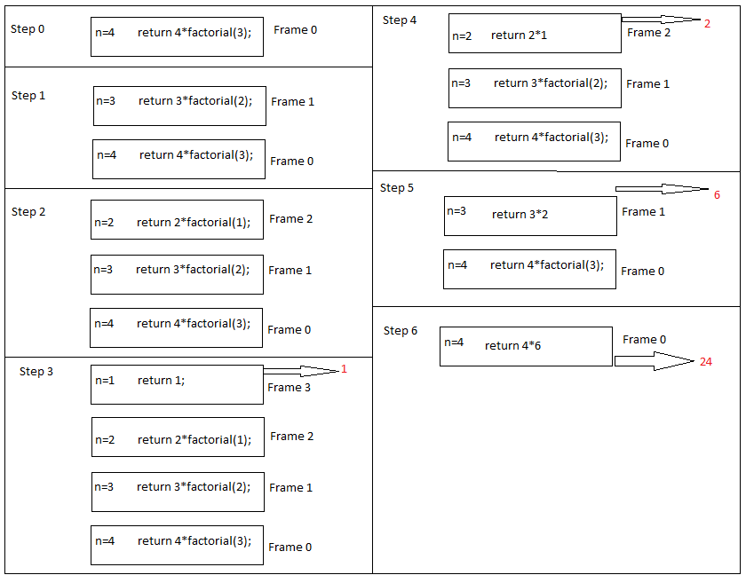

Slide 41
Time Analysis of factorial()
public static long factorial(int n){
if(n<0){
throw new IllegalArgumentExemption();
}
if(n<=1){
return 1;
}
return n*factorial(n-1);
}

Slide 42
Time Analysis of factorial()
public static long factorial(int n){
if(n<0){
throw new IllegalArgumentExemption(); //1
}
if(n<=1){
return 1; //1
}
return n*factorial(n-1); //n-1
}
=O(n)

Slide 43
Iterative v Recursive
All recursive problems can be solved iteratively
Often there is a tradeoff
Time
Space

Slide 44
Iterative Factorial
public static long factorial(int n){
int product=n;
if(n<0){
throw new IllegalArgumentException;
}
if(n==0){
return 1;
}
for(int i=n-1;i>1;i--){
product*=i;
}
return product;
}

Slide 45
Iterative Factorial
public static long factorial(int n){
int product=n;
if(n<0){
throw new IllegalArgumentException; //1
}
if(n==0){
return 1; //1
}
for(int i=n-1;i>1;i--){
product*=i; //n-1
}
return product; //1
}
=O(n)
Space?

Slide 46
Decimal to Binary
Convert base 10 to base 2
n=25? → 11001 → 1*2⁴ + 1*2³ + 0*2² + 0*2¹ + 1*2⁰
In binary, least significant bit = n%2
Remaining bits =n/2

Slide 47
Decimal to Binary
n=12
12/2=6 ; 12%2=0
6/2=3; 6%2=0
3/2=1; 3%2=1
When the n/2 quotient is 1, result is 1.
Then read from the bottom up
12=1100

Slide 48
Decimal to Binary
n/2 needs to be calculated before we append n%2
n%2 is appended to result of recursive call

Slide 49
getBinary
public static String getBinary(int n){
if(n<0){
throw new IllegalArgumentException();
}
if(n<=1) {
return Integer.toString(n);
}
return getBinary(n/2)+Integer.toString(n%2);
}

Slide 50
getBinary
public static String getBinary(int n){
if(n<0){
throw new IllegalArgumentException();
} //1
if(n<=1) {
return Integer.toString(n); //1
}
return getBinary(n/2)+Integer.toString(n%2);
} //floor(log₂n) --splitting rule
=O(log n)

Slide 51
getBinaryIterative
public static String getBinaryIterative(int n){
if(n<0){
throw new IllegalArgumentException();
}
String result="";
int remainder = 0;
while(decimalNumber >= 0) {
remainder = decimalNumber % 2;
decimalNumber /= 2;
result=remainder+result;
}
return(result);
}

Slide 52
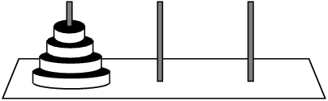
Towers of Hanoi
One disk may move at a time
No big disk ever on top of a smaller disk
Top disk may be moved to any pole
A B C
1
2
3
4

Slide 53
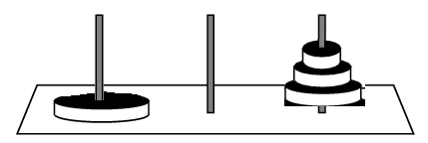
Towers of Hanoi
A B C

Slide 54
Towers of Hanoi
For n disks:
Move n-1 disks from A to C, with B as temporary
Move disk n from A to B
Move n-1 disks from C to B, with A as temporary
A = origin
B = destination
C = temporary

Slide 55
Towers of Hanoi
For n disks:
Move n-1 disks from origin to temporary
Move disk n from origin to destination
Move n-1 disks from temporary to destination
A = origin
B = destination
C = temporary

Slide 56
Towers of Hanoi
public static String move(int n, char orig, char dest, char temp){
final String DIRECT_MOVE=“Move disk “+ n +” from “ + orig + “ to “ + dest + “\n”;
if(n==1) return DIRECT_MOVE;
String result=move(n-1,orig,temp,dest);
result+=DIRECT_MOVE;
result+= move(n-1,temp,dest,orig);
return result;
}

Slide 57
Towers of Hanoi Time Analysis
worstTime(n) for a recursive function is directly proportional to the number of recursive calls
Number of steps to complete any game = 2^{n} -1
worstTime(n) is exponential!
O(2^{n})
Intractable problem

Slide 58
Towers of Hanoi

Slide 59
Array Searching
Searching an array is easy
Start at the beginning, look at every element until you find a match
Return that index
What if the target is at the end?
worstTime(n) is linear, O(n)
Can we do better?

Slide 60
Binary Search
Divide-and-conquer
Assume sorted collection
Input:
the collection
smallest index (0)
largest index
key (target)

Slide 61
Binary Search
Find midpoint of collection
Compare that to key
If greater, search the first half
If lesser, search the last half
If equal, you are done!
Return the index where the key was found

Slide 62
Comparable Interface
public interface Comparable{
//Return less than zero if this is less than obj
//Return greater than zero if this is greater than obj
//Return zero if this is equal to obj
public int compareTo(Object obj)
}
String s = “hello”;
s.compareTo(“world”); //return less than zero
Integer i = 4;
i.compareTo(3); //return greater than zero

Slide 63
Build Binary Search

Slide 64
Conclusion
Recursion is a method calling itself
Iterative solutions are preferable to recursive solutions
If the problem complexity can be reduced to simpler cases in the same form
Simplest case can be solved directly
Any recursive method can be made iterative
Its not always better!

Slide 65
Homework 2

